Slide 1

Character-Level Translation with Self-attention
Yingqiang Gao, Nikola I. Nikolov, Yuhuang Hu, Richard H.R. Hahnloser
Department of Informatics, Technical University of Munich Institute of Neuroinformatics, University of Zurich and ETH Zurich

Slide 2


About the author
Personal profile
Birdsong and Natural Language Group
We research the algorithms inherent in birdsong learning and their relevance for natural language processing. The premise for our work is that behavior provides clues about natural intelligence, i.e., the algorithms for solving a problem.

Slide 3
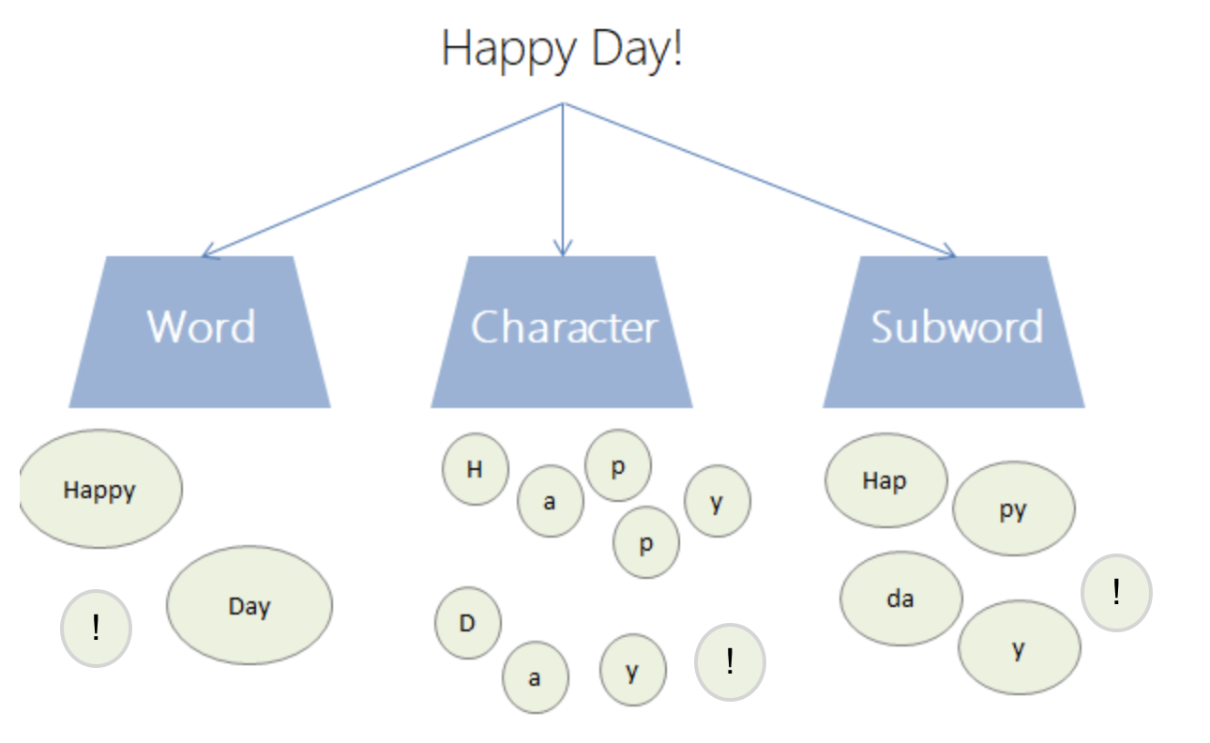
Granularity in Machine Translation
Word
Problem:out of words
Subword
How to generate subwords?
BPE(Byte Pair Encoding)
WordPiece
Character

Slide 4
An example of BPE
Input : {'l o w </w>': 5, 'l o w e r </w>': 2, 'n e w e s t </w>': 6, 'w i d e s t </w>': 3}
Iter 1: {'l o w </w>': 5, 'l o w e r </w>': 2, 'n e w es t </w>': 6, 'w i d es t </w>': 3}
Iter 2： {'l o w </w>': 5, 'l o w e r </w>': 2, 'n e w est </w>': 6, 'w i d est </w>': 3}
Iter 3： {'l o w </w>': 5, 'l o w e r </w>': 2, 'n e w est</w>': 6, 'w i d est</w>': 3}
……
Iter n: The preset subword vocabulary size is reached or the next highest frequency byte pair appears to be 1.
Notes:
统计每一个连续字节对的出现频率，选择最高频者合并成新的subword
有点像聚簇，最初每个子词都只有一个字符。

Slide 5
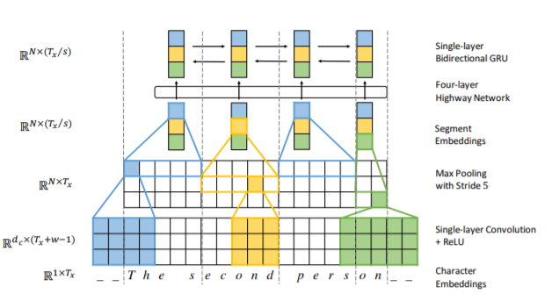

A Character-Level NMT model proposed before
Encoder architecture
Tx : The number of characters
in the sentence
w : The width of the filter
dc : The size of character embedding
N : The number of filters,equals to dc
s : Stride
Notes:
文章中有多处该模型和作者提出的模型之间的比较，由ETH计算机学院的研究人员提出。
第一个真正意义上使用字符级机器翻译的模型。
不同的上下文窗口大小旨在类似于不同粒度级别的字符级别交互，例如在子单词级别或单词级别。
segment包含了相邻字符间的信息。
其实还是使用maxpooling后，一个向量代表一个词。
N*Tx中，每一层对应一个w值。
max pooling选择最显著的特征。其实max pooling之后的过程就有些类似subword或是word级的翻译了。
1维卷积并不是指核的size为1*n，而是只在一个维度进行卷积。
在attention出现之前，使用gru解决梯度消失（即长期记忆问题）。

Slide 6
Motivication
Target
To investigate the utility of self-attention models for character-level translation.
Challenge
Individual character representations might provide limited semantic information for learning meaningful relations on the sentence level.
Notes:
模型上的创新很简单，在transformer的基础上加了一个卷积块

Slide 7
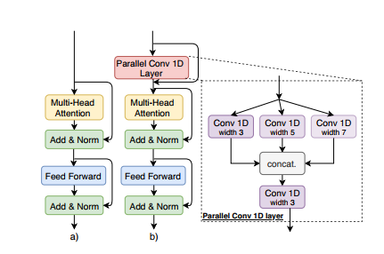
A variant of Transformer
Encoder architecture
$$Conv\left(M\right)=M+C_{3}^{′}(Concat(C_{3}\left(M\right),C_{5}\left(M\right),C_{7}(M)))$$
Notes:
in contrast to Lee et al. (2017), who use max-pooling to compress the input character sequence into segments of characters, here we leave the resolution unchanged.
attention之前，先通过一个卷积块
通过了卷积块之后，每个字符已经携带了相邻字符的信息，从某种意义上来讲，字符已经具有了subword或是word的含义。
最后一次卷积将此前卷积的结果进行融合
decoder一样

Slide 8
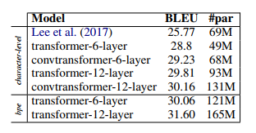
Model comparison
Character-level training is 3 to 5 times
slower than subword-level training.
The standard transformer trained at the
character level already achieves very good
performance.
On this dataset, our convtransformer variant
performs on par with the character-level transformer.
Character-level transformers perform competitively
with equivalent BPE models while requiring fewer parameters.

Slide 9
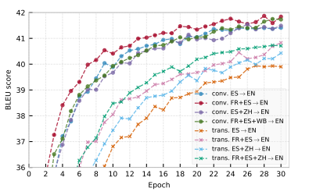
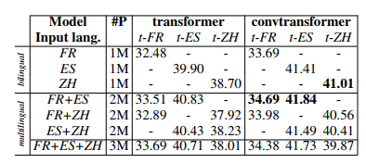
Multilingual experiments
The convtransformer outperforms the character-level transformer.
Training multilingual models on similar input languages leads to improved
performance for both languages.
Distant-language training seems to be helpful mainly when the input language
is closer to the target translation language .
The convtransformer reaches comparable performance in less epochs.

Slide 10
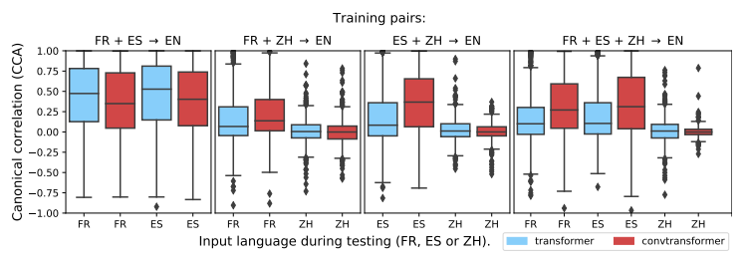
Analysis of Learned Alignments
Quantify the alignments using canonical correlation analysis (CCA)
The convtransformer is more robust to the introduction of a distant language than the transformer.
Notes:
典型相关分析

Slide 11
Difference between Transformer and Convtransformer
Performance
Convtransformer behaves better while more parameters are needed.
Speed
Convtransformer training is faster than standard transformer.
Robustness
The convtransformer is more robust to the introduction of a distant language than the transformer

Slide 12
Conclusion
Character vs Subword
With character-level architectures performing competitively when compared to equivalent subword-level architectures while requiring fewer parameters.
Training performance on multiple input languages
Training on multiple input languages leads to improvements across all languages when the source and target languages are similar. When the languages are different, we observe a drop in performance, in particular for the distant language.

Slide 13
Thanks!

